Slide 1


Time Series Analysis
Anshu Pandey

Slide 2

Learning Objectives
Describe what forecasting is
Explain time series & its components
Smooth a data series
Moving average
Exponential smoothing
Forecast using trend models
Simple Linear Regression
Auto-regressive
Notes:
2
As a result of this class, you will be able to...

Slide 3
What Is Forecasting?
Process of predicting a future event
Underlying basis of all business decisions
Production
Inventory
Personnel
Facilities
Notes:
4

Slide 4
Forecasting Approaches
Qualitative Methods
Quantitative Methods
Used when situation is vague & little data exist
New products
New technology
Involve intuition, experience
e.g., forecasting sales on Internet
Notes:
5

Slide 5
Forecasting Approaches
Qualitative Methods
Quantitative Methods
Used when situation is vague & little data exist
New products
New technology
Involve intuition, experience
e.g., forecasting sales on Internet
Used when situation is ‘stable’ & historical data exist
Existing products
Current technology
Involve mathematical techniques
e.g., forecasting sales of color televisions
Notes:
6

Slide 6
Quantitative Forecasting
Select several forecasting methods
‘Forecast’ the past
Evaluate forecasts
Select best method
Forecast the future
Monitor continuously forecast accuracy
Notes:
7

Slide 7
Quantitative Forecasting Methods
Notes:
8

Slide 8
Quantitative Forecasting Methods
Quantitative
Forecasting
Notes:
9

Slide 9
Quantitative Forecasting Methods
Quantitative
Forecasting
Time Series
Models
Notes:
10

Slide 10
Quantitative Forecasting Methods
Quantitative
Forecasting
Time Series
Causal
Models
Models
Notes:
11

Slide 11
Quantitative Forecasting Methods
Quantitative
Forecasting
Time Series
Causal
Models
Models
Moving
Exponential
Trend
Average
Smoothing
Models
Notes:
12

Slide 12
Quantitative Forecasting Methods
Quantitative
Forecasting
Time Series
Causal
Models
Models
Moving
Exponential
Trend
Regression
Average
Smoothing
Models
Notes:
13

Slide 13
Quantitative Forecasting Methods
Quantitative
Forecasting
Time Series
Causal
Models
Models
Moving
Exponential
Trend
Regression
Average
Smoothing
Models
Notes:
15

Slide 14
What is a Time Series?
Set of evenly spaced numerical data
Obtained by observing response variable at regular time periods
Forecast based only on past values
Assumes that factors influencing past, present, & future will continue
Example
Year: 1995 1996 1997 1998 1999
Sales: 78.7 63.5 89.7 93.2 92.1
Notes:
16

Slide 15
Time Series vs. Cross Sectional Data
Time series data is a sequence of observations
collected from a process
with equally spaced periods of time.

Slide 16
Time Series vs. Cross Sectional Data
Contrary to restrictions placed on cross-sectional data, the major purpose of forecasting with time series is to extrapolate beyond the range of the explanatory variables.

Slide 17
Time Series vs. Cross Sectional Data
Time series is dynamic, it does change over time.

Slide 18
Time Series vs. Cross Sectional Data
When working with time series data, it is paramount that the data is plotted so the researcher can view the data.

Slide 19
Time Series Components
Notes:
17

Slide 20
Time Series Components
Trend
Notes:
18

Slide 21
Time Series Components
Trend
Cyclical
Notes:
19

Slide 22
Time Series Components
Trend
Cyclical
Seasonal
Notes:
20

Slide 23
Time Series Components
Trend
Cyclical
Seasonal
Irregular
Notes:
21

Slide 24
Trend Component
Persistent, overall upward or downward pattern
Due to population, technology etc.
Several years duration
Response
Mo., Qtr., Yr.
© 1984-1994 T/Maker Co.
Notes:
22

Slide 25
Trend Component
Overall Upward or Downward Movement
Data Taken Over a Period of Years
Sales
Upward trend
Time

Slide 26
Cyclical Component
Repeating up & down movements
Due to interactions of factors influencing economy
Usually 2-10 years duration
Cycle
Response
Mo., Qtr., Yr.
Notes:
23

Slide 27
Cyclical Component
Upward or Downward Swings
May Vary in Length
Usually Lasts 2 - 10 Years
Sales
Cycle
Time

Slide 28
Seasonal Component
Regular pattern of up & down fluctuations
Due to weather, customs etc.
Occurs within one year
Summer
Response
© 1984-1994 T/Maker Co.
Mo., Qtr.
Notes:
24

Slide 29
Seasonal Component
Upward or Downward Swings
Regular Patterns
Observed Within One Year
Sales
Winter
Time (Monthly or Quarterly)

Slide 30
Irregular Component
Erratic, unsystematic, ‘residual’ fluctuations
Due to random variation or unforeseen events
Union strike
War
Short duration & nonrepeating
© 1984-1994 T/Maker Co.
Notes:
25

Slide 31
Random or Irregular Component
Erratic, Nonsystematic, Random, ‘Residual’ Fluctuations
Due to Random Variations of
Nature
Accidents
Short Duration and Non-repeating

Slide 32
Time Series Forecasting
Notes:
27

Slide 33
Time Series Forecasting
Time
Series
Notes:
28

Slide 34
Time Series Forecasting
Time
Series
Trend?
Notes:
29

Slide 35
Time Series Forecasting
Time
Series
Smoothing
No
Methods
Trend?
Notes:
30

Slide 36
Time Series Forecasting
Time
Series
Smoothing
No
Yes
Trend
Methods
Trend?
Models
Notes:
31

Slide 37
Time Series Forecasting
Time
Series
Smoothing
No
Yes
Trend
Methods
Trend?
Models
Moving
Exponential
Average
Smoothing
Notes:
32

Slide 38
Time Series Forecasting
Notes:
33

Slide 39
Time Series Analysis

Slide 40
Plotting Time Series Data

Slide 41
Moving Average Method
Notes:
34

Slide 42
Time Series Forecasting
Notes:
35

Slide 43
Moving Average Method
Series of arithmetic means
Used only for smoothing
Provides overall impression of data over time
Notes:
36

Slide 44
Moving Average Method
Series of arithmetic means
Used only for smoothing
Provides overall impression of data over time
Used for elementary forecasting
Notes:
37

Slide 45
Moving Average Graph
Sales
Actual
Year
Notes:
53

Slide 46
Moving Average [An Example]
You work for Firestone Tire. You want to smooth random fluctuations using a 3-period moving average. 1995 20,000 1996 24,000 1997 22,000 1998 26,000 1999 25,000
Notes:
54

Slide 47
Moving Average [Solution]
Year Sales MA(3) in 1,000
1995 20,000 NA
1996 24,000 (20+24+22)/3 = 22
1997 22,000 (24+22+26)/3 = 24
1998 26,000 (22+26+25)/3 = 24
1999 25,000 NA
Notes:
55

Slide 48
Moving Average
Year Response Moving Ave
1994 2 NA
1995 5 3
1996 2 3
1997 2 3.67
1998 7 5
1999 6 NA
Sales
8
6
4
2
0
94 95 96 97 98 99

Slide 49
Exponential Smoothing Method
Notes:
56

Slide 50
Time Series Forecasting
Notes:
57

Slide 51
Exponential Smoothing Method
Form of weighted moving average
Weights decline exponentially
Most recent data weighted most
Requires smoothing constant (W)
Ranges from 0 to 1
Subjectively chosen
Involves little record keeping of past data
Notes:
58

Slide 52
Exponential Smoothing [An Example]
You’re organizing a Kwanza meeting. You want to forecast attendance for 1998 using exponential smoothing (α = .20). Past attendance (00) is: 1995 4 1996 6 1997 5 1998 3 1999 7
© 1995 Corel Corp.
Notes:
63

Slide 53
Exponential Smoothing
E_{i} = W·Y_{i} + (1 - W)·E_{i-1}
^
Notes:
81

Slide 54
Exponential Smoothing [Graph]
Attendance
Actual
Year
Notes:
82

Slide 55
Forecast Effect of Smoothing Coefficient (W)
^
Y_{i+1} = W·Y_{i} + W·(1-W)·Y_{i-1} + W·(1-W)²·Y_{i-2} +...
Notes:
86

Slide 56
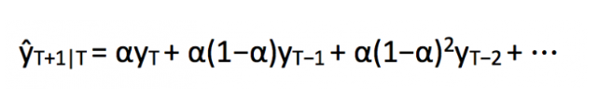
Simple Exponential Smoothing

Slide 57
Simple Exponential Smoothing
from statsmodels.tsa.api import ExponentialSmoothing, SimpleExpSmoothing, Holt
y_hat_avg = test.copy()
fit2 = SimpleExpSmoothing(np.asarray(train['Count'])).fit(smoothing_level=0.6,optimized=False)
y_hat_avg['SES'] = fit2.forecast(len(test))
plt.figure(figsize=(16,8))
plt.plot(train['Count'], label='Train')
plt.plot(test['Count'], label='Test')
plt.plot(y_hat_avg['SES'], label='SES')
plt.legend(loc='best')
plt.show()

Slide 58
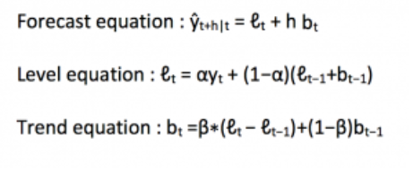
Holt’s Linear Trend method

Slide 59
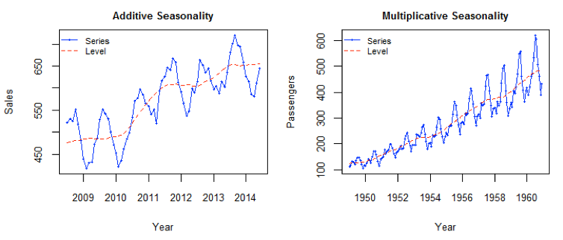

Slide 60
Holt’s Linear Trend method
y_hat_avg = test.copy()
fit1 = Holt(np.asarray(train['Count'])).fit(smoothing_level = 0.3,smoothing_slope = 0.1)
y_hat_avg['Holt_linear'] = fit1.forecast(len(test))
plt.figure(figsize=(16,8))
plt.plot(train['Count'], label='Train')
plt.plot(test['Count'], label='Test')
plt.plot(y_hat_avg['Holt_linear'], label='Holt_linear')
plt.legend(loc='best')
plt.show()
rms = sqrt(mean_squared_error(test.Count, y_hat_avg.Holt_linear))
print(rms)

Slide 61
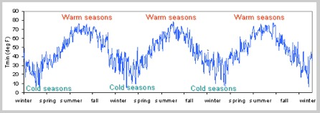
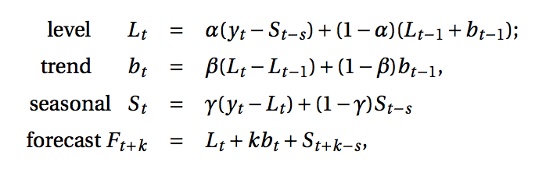
Holt-Winters Method

Slide 62
Holt-Winters Method
y_hat_avg = test.copy()
fit1 = ExponentialSmoothing(np.asarray(train['Count']) ,seasonal_periods=7 ,trend='add', seasonal='add',).fit()
y_hat_avg['Holt_Winter'] = fit1.forecast(len(test))
plt.figure(figsize=(16,8))
plt.plot( train['Count'], label='Train')
plt.plot(test['Count'], label='Test')
plt.plot(y_hat_avg['Holt_Winter'], label='Holt_Winter')
plt.legend(loc='best')
plt.show()

Slide 63
Linear Time-Series Forecasting Model
Notes:
87

Slide 64
Time Series Forecasting
Notes:
88

Slide 65
Linear Time-Series Forecasting Model
Used for forecasting trend
Relationship between response variable Y & time X is a linear function
Coded X values used often
Year X: 1995 1996 1997 1998 1999
Coded year: 0 1 2 3 4
Sales Y: 78.7 63.5 89.7 93.2 92.1
Notes:
89

Slide 66
Linear Time-Series Model
b₁ > 0
b₁ < 0
Notes:
90

Slide 67
Linear Time-Series Model [An Example]
You’re a marketing analyst for Hasbro Toys. Using coded years, you find Y_{i} = .6 + .7X_{i}.
1995 1 1996 1 1997 2 1998 2 1999 4
Forecast 2000 sales.
^
Notes:
91

Slide 68
Linear Time-Series [Example]
Year Coded Year Sales (Units) 1995 0 1 1996 1 1 1997 2 2 1998 3 2 1999 4 4 2000 5 ?
2000 forecast sales: Y_{i} = .6 + .7·(5) = 4.1
The equation would be different if ‘Year’ used.
^
Notes:
92

Slide 69
The Linear Trend Model
Year Coded Sales
94 0 2
95 1 5
96 2 2
97 3 2
98 4 7
99 5 6
Projected to year 2000
Excel Output

Slide 70
Time Series Plot

Slide 71
Time Series Plot [Revised]

Slide 72
Seasonality Plot

Slide 73
Trend Analysis

Slide 74
Quadratic Time-Series Forecasting Model
Notes:
93

Slide 75
Time Series Forecasting
Notes:
94

Slide 76
Quadratic Time-Series Forecasting Model
Used for forecasting trend
Relationship between response variable Y & time X is a quadratic function
Coded years used
Notes:
95

Slide 77
Quadratic Time-Series Forecasting Model
Used for forecasting trend
Relationship between response variable Y & time X is a quadratic function
Coded years used
Quadratic model
Notes:
96

Slide 78
Quadratic Time-Series Model Relationships
b₁₁ > 0
b₁₁ > 0
b₁₁ < 0
b₁₁ < 0
Notes:
97

Slide 79
Quadratic Trend Model
Year Coded Sales
94 0 2
95 1 5
96 2 2
97 3 2
98 4 7
99 5 6
Excel Output

Slide 80
Exponential Time-Series Model
Notes:
98

Slide 81
Time Series Forecasting
Notes:
99

Slide 82
Exponential Time-Series Forecasting Model
Used for forecasting trend
Relationship is an exponential function
Series increases (decreases) at increasing (decreasing) rate
Notes:
100

Slide 83
Exponential Time-Series Forecasting Model
Used for forecasting trend
Relationship is an exponential function
Series increases (decreases) at increasing (decreasing) rate
Notes:
101

Slide 84
Exponential Time-Series Model Relationships
b₁ > 1
0 < b₁ < 1
Notes:
102

Slide 85
Exponential Weight [Example Graph]
Sales
8
6
4
2
0
Data
Smoothed
94 95 96 97 98 99
Year

Slide 86
Exponential Trend Model
or
Year Coded Sales
94 0 2
95 1 5
96 2 2
97 3 2
98 4 7
99 5 6
Excel Output of Values in logs

Slide 87
Autoregressive Modeling
Notes:
103

Slide 88
Time Series Forecasting
Notes:
104

Slide 89
Autoregressive Modeling
Used for forecasting trend
Like regression model
Independent variables are lagged response variables Y_{i-1}, Y_{i-2}, Y_{i-3} etc.
Assumes data are correlated with past data values
1st Order: Correlated with prior period
Estimate with ordinary least squares
Notes:
105

Slide 90
Time Series Data Plot

Slide 91
Auto-correlation Plot

Slide 92
Autoregressive Model [An Example]
The Office Concept Corp. has acquired a number of office units (in thousands of square feet) over the last 8 years. Develop the 2nd order Autoregressive models.
Year Units
92 4
93 3
94 2
95 3
96 2
97 2
98 4
99 6

Slide 93
Autoregressive Model [Example Solution]
Develop the 2nd order table
Use Excel to run a regression model
Year Y_{i} Y_{i-1} Y_{i-2}
92 4 --- ---
93 3 4 ---
94 2 3 4
95 3 2 3
96 2 3 2
97 2 2 3
98 4 2 2
99 6 4 2
Excel Output

Slide 94
Evaluating Forecasts
Notes:
112

Slide 95
Quantitative Forecasting Steps
Select several forecasting methods
‘Forecast’ the past
Evaluate forecasts
Select best method
Forecast the future
Monitor continuously forecast accuracy
☞
Notes:
113

Slide 96
Forecasting Guidelines
No pattern or direction in forecast error
e_{i} = (Actual Y_{i} - Forecast Y_{i})
Seen in plots of errors over time
Smallest forecast error
Measured by mean absolute deviation
Simplest model
Called principle of parsimony
Notes:
114

Slide 97
Pattern of Forecast Error
Trend Not Fully Accounted for
Desired Pattern
Notes:
115

Slide 98
Residual Analysis
e
e
0
0
T
T
Random errors
Cyclical effects not accounted for
e
e
0
0
T
T
Trend not accounted for
Seasonal effects not accounted for

Slide 99
Principal of Parsimony
Suppose two or more models provide good fit for data
Select the Simplest Model
Simplest model types:
least-squares linear
least-square quadratic
1st order autoregressive
More complex types:
2nd and 3rd order autoregressive
least-squares exponential

Slide 100
Summary
Described what forecasting is
Explained time series & its components
Smoothed a data series
Moving average
Exponential smoothing
Forecasted using trend models
Notes:
121

Slide 101
You and StatGraphics
Specification
[Know assumptions underlying various models.]
Estimation
[Know mechanics of StatGraphics Plus Win].
Diagnostic checking

Slide 102
Questions?

Slide 103
Source of Elaborate Slides
Prentice Hall, Inc
Levine, et. all, First Edition

